Slide 1
Disaster Tweets Classification Using pySpark
CS777 Term project
Maryam Asghari

Slide 2
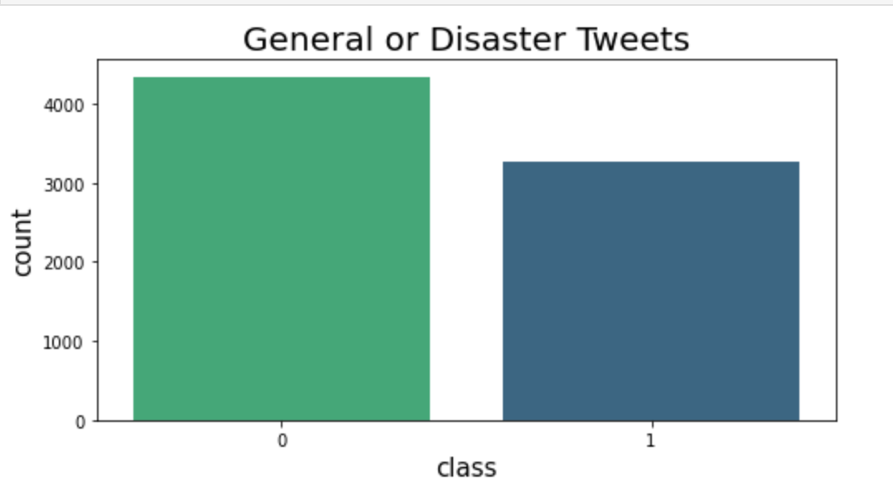
Dataset

Slide 3
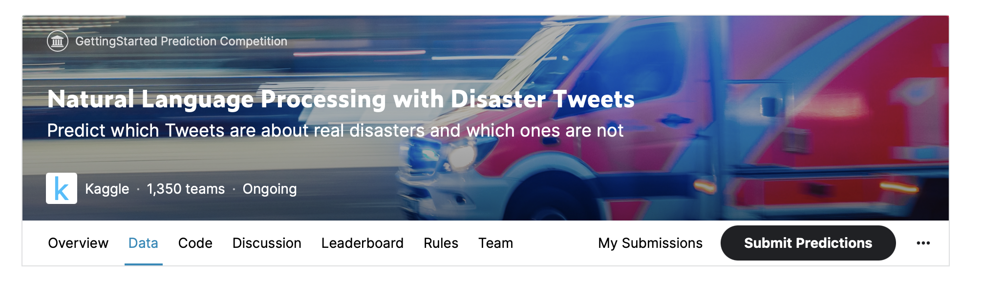
Dataset
Columns
id - a unique identifier for each tweet
text - the text of the tweet
location - the location the tweet was sent from (may be blank)
keyword - a particular keyword from the tweet (may be blank)
target - in train.csv only, this denotes whether a tweet is about a real disaster (1) or not (0)
Source : https://www.kaggle.com/c/nlp-getting-started/data

Slide 4
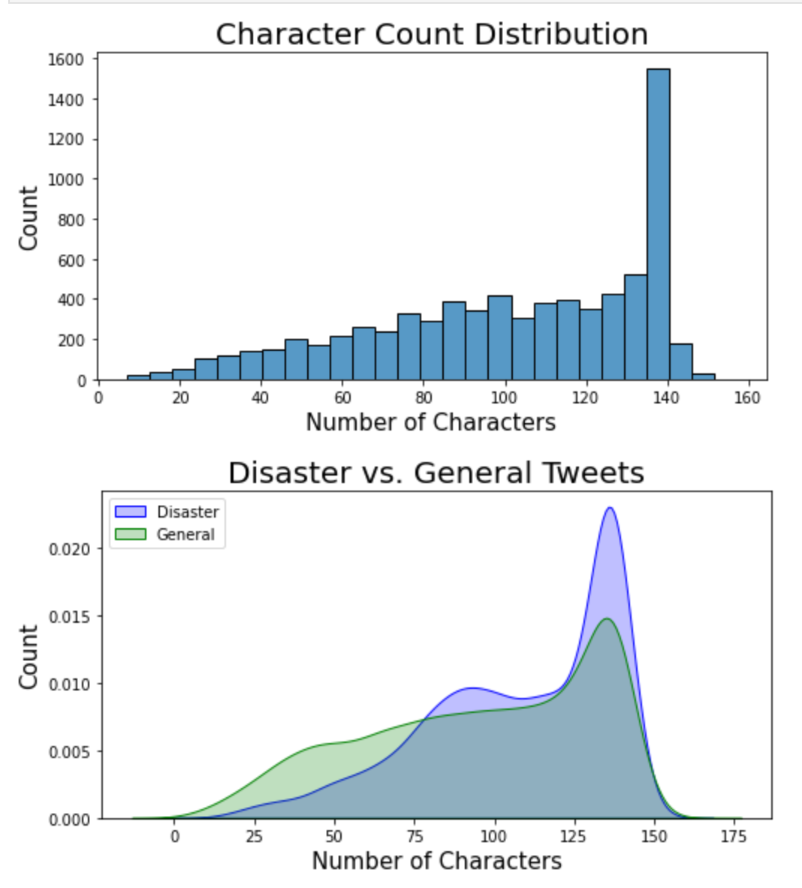
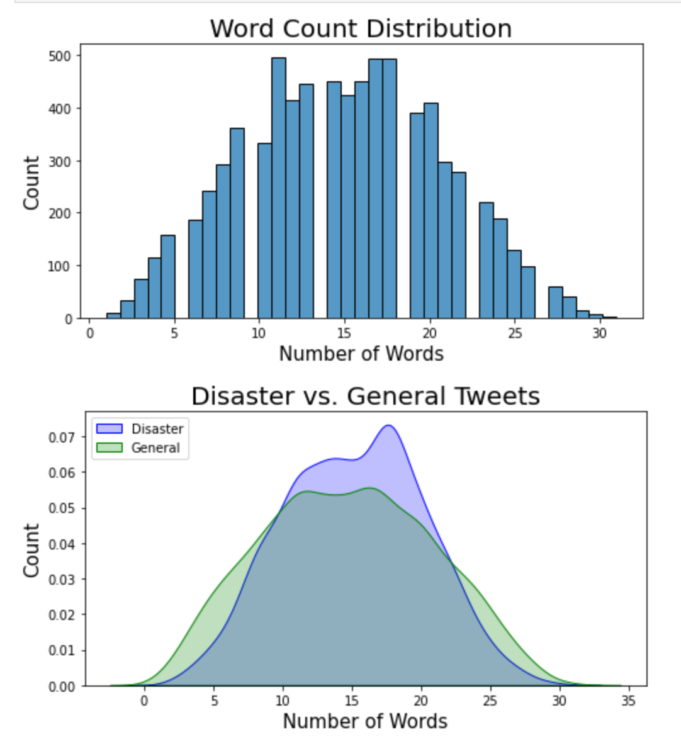
Character and Words

Slide 5
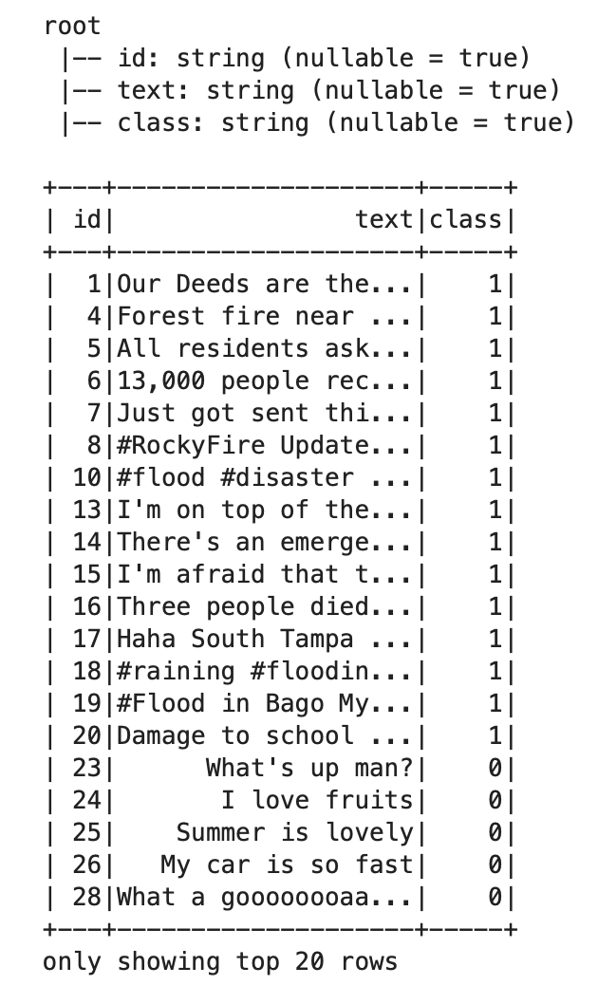
Preprocessing

Slide 6
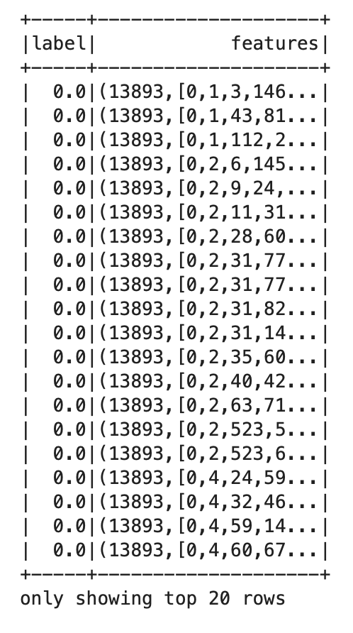
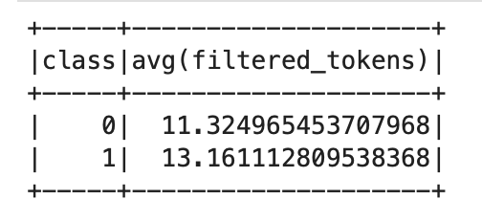
Using UDF and Libraries
Lower case
Remove websites and mentions
Remove all non letter characters
Remove Stop words
Tokenize
Tf_idf
Vector of features
Split to train and test set
Average word count in each group

Slide 7
Classification Using ml libraries
Naïve Bayes
Logistic Regression
SVM
Decision Tree
Random Forest
GBT - Gradient Boosted Tree

Slide 8
Using Pyspark Libraries for Classification
Classifier | Lib | DS | Accuracy | F1 | Train T | Test T
Logistic Regression | Ml | dataframe | %79.16 | %78.2 | 6.698 | 0.0311
SVM | Ml | dataframe | %78.02 | %77.60 | 44.4904 | 0.0226
Naïve Bayes | Ml | dataframe | %78.41 | %78.4 | 4.5829 | 0.0354
Decision Tree | Ml | dataframe | %60.62 | %49.9 | 12.4768 | 0.0373
Random Forest | Ml | dataframe | %62.09 | %52.30 | 5.03 | 0.037
GBT | Ml | dataframe | %73.45 | %71.5 | 39.57 | 0.0539

Slide 9
Different regularization parameter
Reg parameter | Accuracy | F1
0.0001 | %74.56 | %774.53
0.001 | %75.81 | %75.71
0.01 | %77.57 | %77.39
0.1 | %77.82 | %77.47
1 | %78.38 | %77.45
10 | %65.60 | %57.65
Reg parameter | Accuracy | F1
0.0001 | %76.31 | %76.19
0.001 | %76.31 | %76.2
0.01 | %76.25 | %76.14
0.1 | %77.22 | %77.09
1 | %77.73 | %77.51
10 | %60.91 | %48.20
Logistic regression
SVM

Slide 10
RDD Implementations
Preprocessing
Dictionary of top 10k
Implementation from scratch
Logistic regression
SVM
3 layers Neural Network

Slide 11
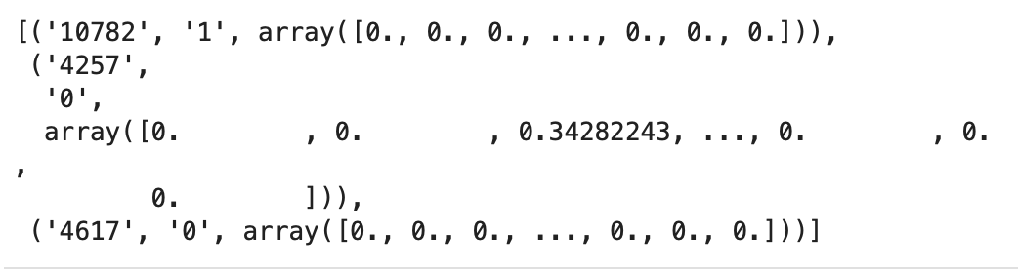
Using NLTK
Lower case
Remove websites and mentions
Remove all non letter characters
Remove Stop words
lemmatize
Tokenize
Tf_idf
Vector of features
Split to train and test set

Slide 12

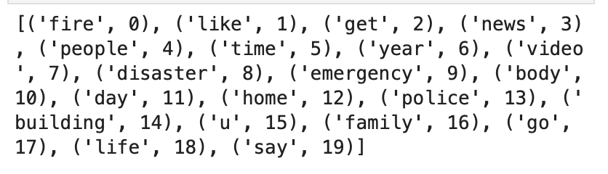
Dictionary of 10k words
Top words in all Tweets

Slide 13

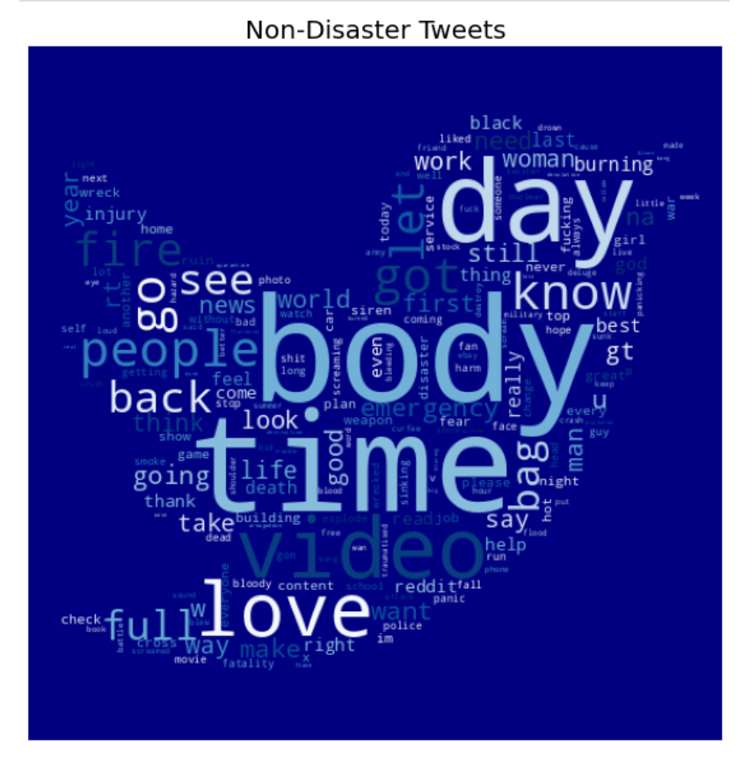
Disaster vs. Non-Disaster

Slide 14
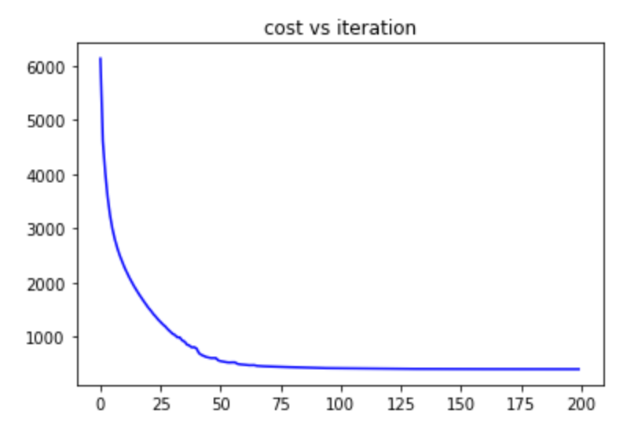
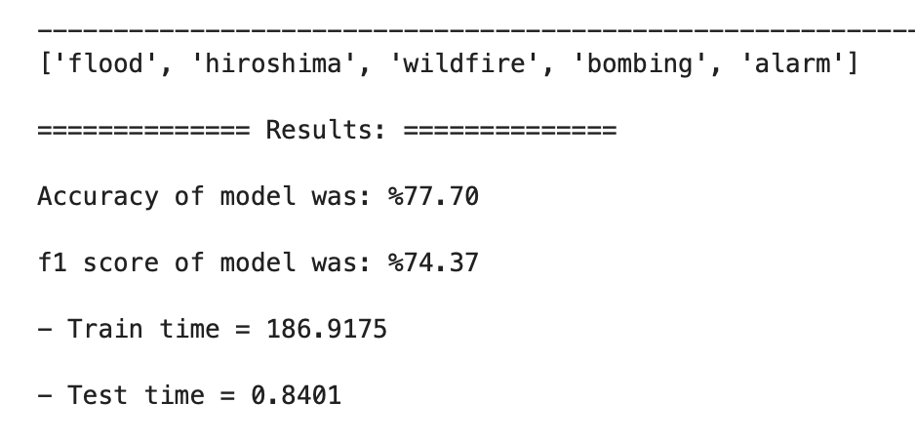
SVM
The top 5 words with largest coefficients

Slide 15
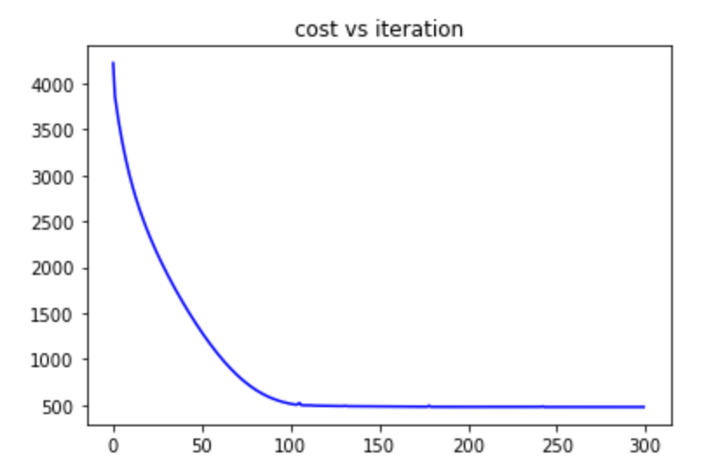
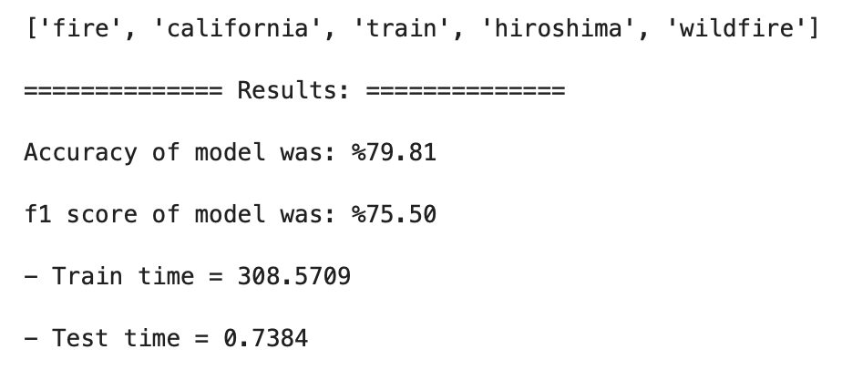
Logistic Regression
The top 5 words with largest coefficients
Dictionary | DS | Accuracy | F1
10K Top All | RDD | %79.81 | %75.50
10K Top Disaster | RDD | %79.25 | %74.86

Slide 16
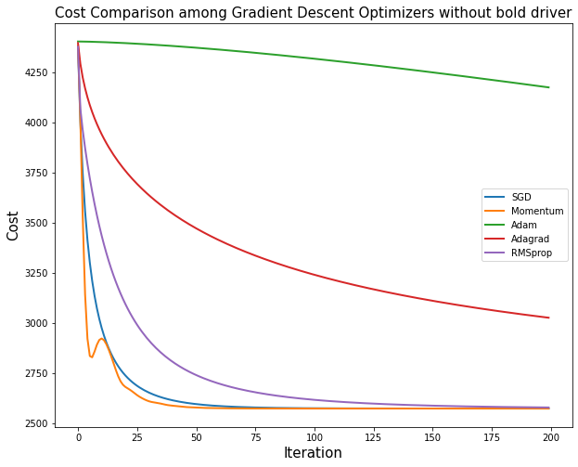
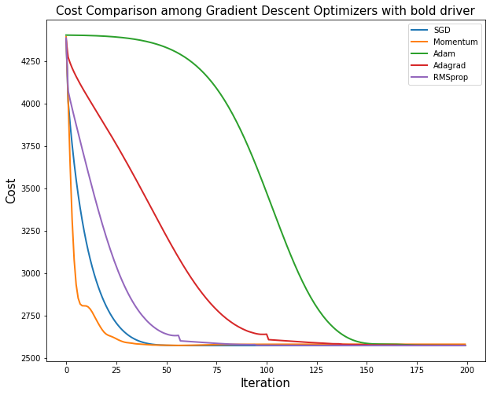
Logistic Regression with different Gradient Descent Optimizers

Slide 17
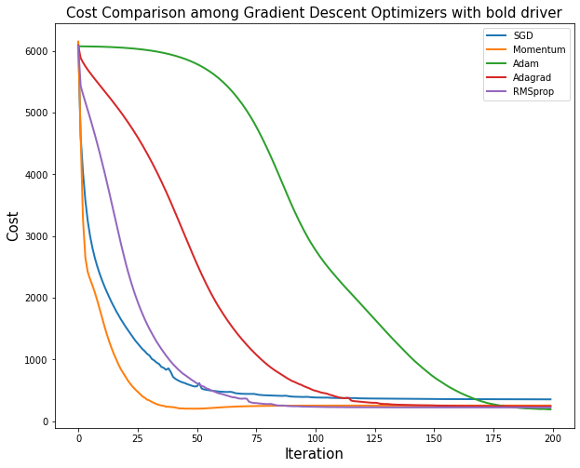
SVM with different Gradient Descent Optimizers

Slide 18
Logistic Regression vs. SVM
Optimizer | Accuracy | F1
SGD | %79.81 | %75.50
Momentum (216 iter) | %80.01 (%80.15) | %75.92 (%76.08)
Nesterov | %79.35 | %76.18
Adam | %79.95 | %75.62
Adagrad | %80.08 | %75.78
RMSprop | %79.88 | %75.56
Optimizer | Accuracy | F1
SGD | %76.31 | %72.92
Momentum | %75.45 | %71.92
Nesterov | %75.31 | %71.72
Adam | %74.12 | %70.27
Adagrad | %73.53 | %69.56
RMSprop | %74.06 | %70.17
Logistic regression , 200 iteration
SVM, 200 iteration

Slide 19
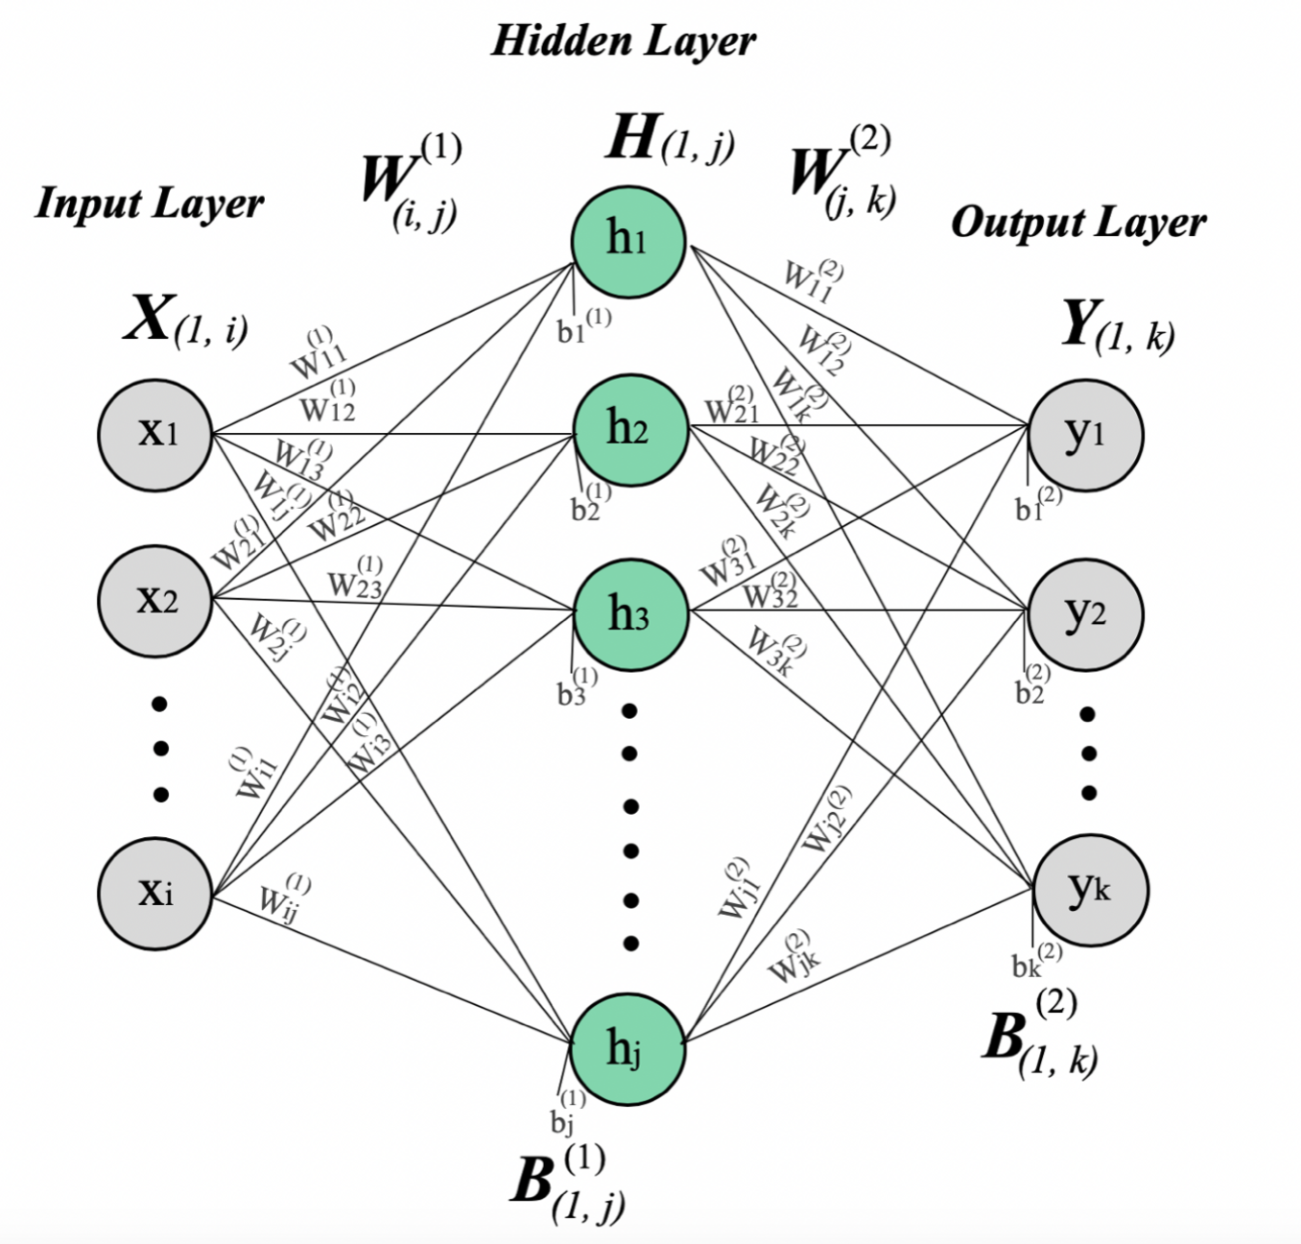
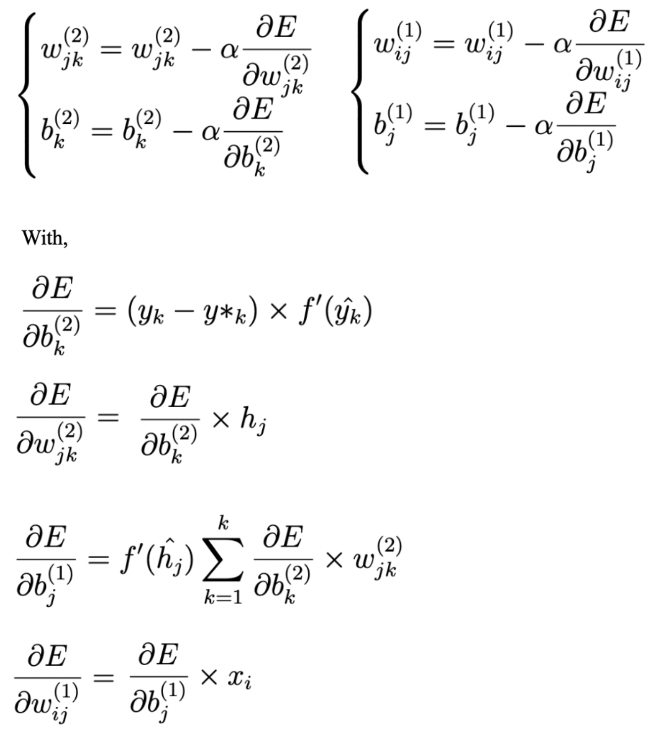
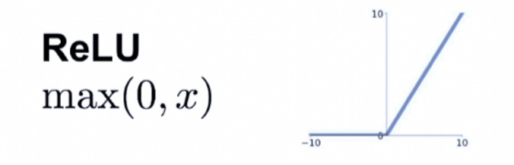
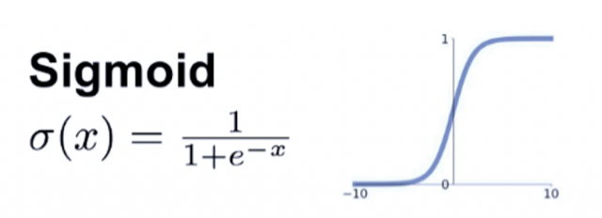
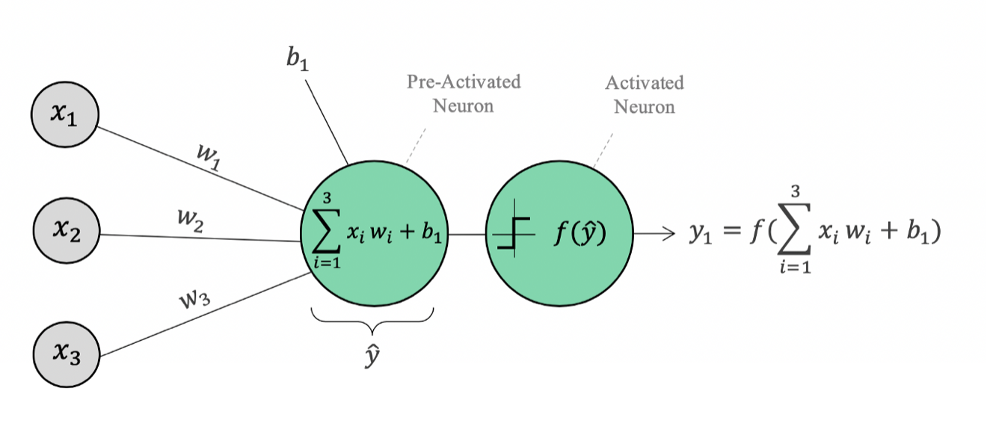
3 layers Neural Network

